Slide 1
Physics Semester Introduction
In this course you will learn about physics, which is the study of matter and the changes it undergoes.
Welcome to Physics

Slide 2
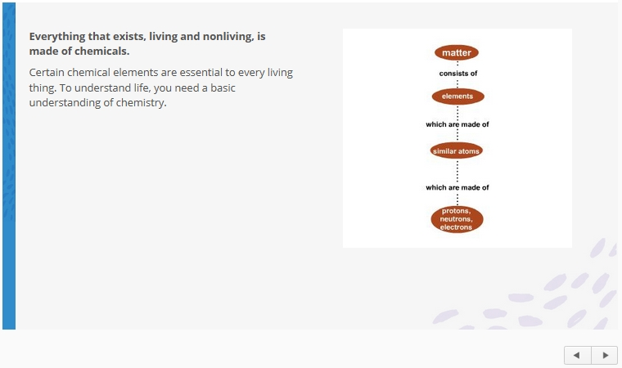
Online Activities: Standard Lessons
All of the lessons are presented online, and all are designed to last about 60 minutes.
Some lessons also have offline components.
Standard lessons are designed to deepen your understanding of scientific concepts. Each lesson begins with an overview of the lesson, the Lesson Goals, and a Mastery Map that leads you visually through the major concepts of the lesson. You will revisit the Mastery Map at the end of each lesson.

Slide 3
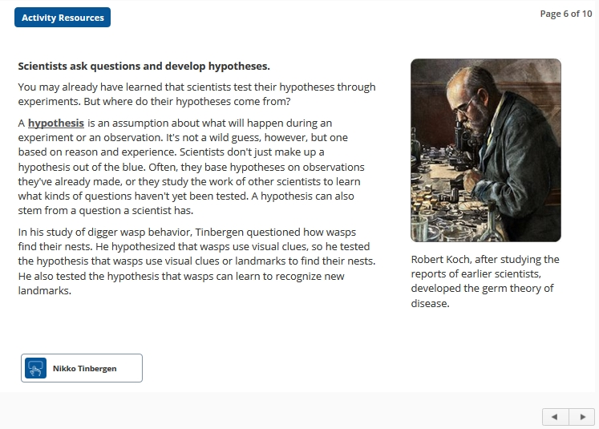
Online Activities: Standard Lesson Screens
Standard lesson screens may feature one or more special components. Animations and interactive pieces help teach important scientific processes and concepts. Hyperlinked keywords give you immediate access to definitions and pronunciations. Links to websites let you explore beyond the limits of the lesson.

Slide 4
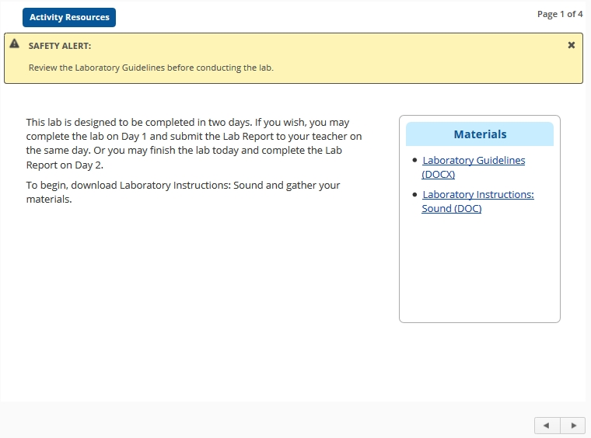
Online Activities: Lab Lessons
Lab lessons give you hands-on experience conducting scientific experiments and investigations. Lab lessons usually follow a set of standard lessons, and they give you an opportunity to see how the ideas you’ve been studying apply to real-life situations.

Slide 5
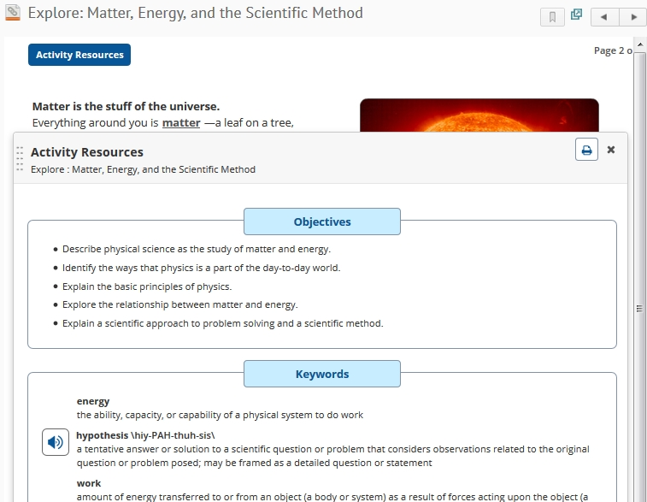
Online Activities: Lesson Resources
Notice the resources button in the top left corner of the lesson screens. This button may be labeled Lesson Resources or Activity Resources. The resources pop-up gives you quick access to objectives, keywords, links and a list of materials you will need to complete the lesson.

Slide 6
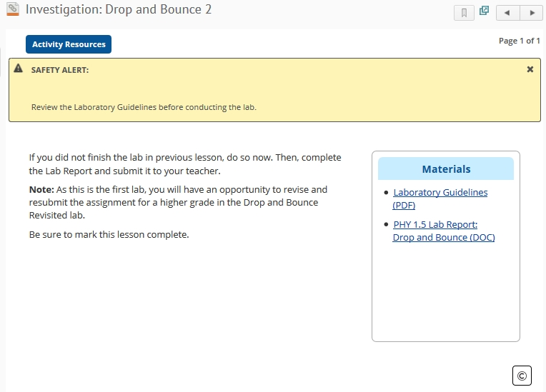
Offline Activities
Offline activities include lab experiments and investigations.

Slide 7
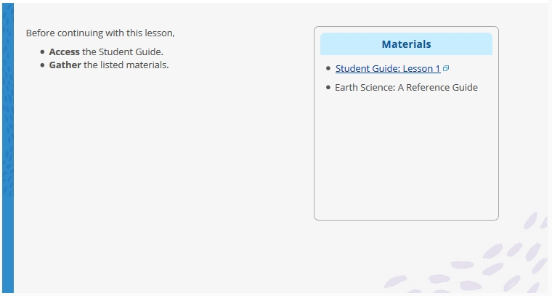
Offline Activities: Student Guide
The Student Guide is a printable document that you can access from a link within each lesson. The Student Guide includes lesson components such as keywords, materials, and advance preparation instructions, as well as directions on how to complete lesson activities, labs, or tests. It also serves as a handy place to take notes as you read through a lesson.

Slide 8
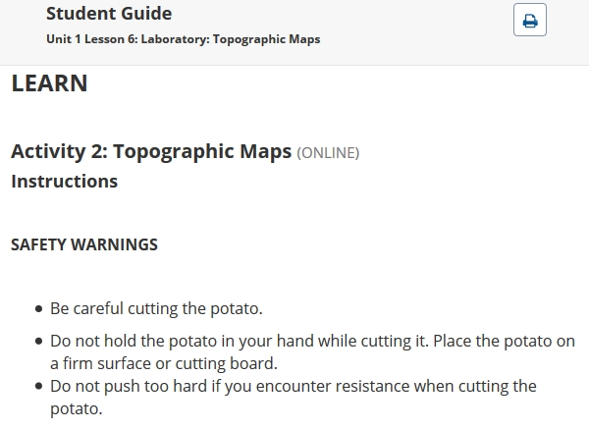
Offline Activities: Materials and Safety
Pay careful attention to the Materials and Safety sections of the Student Guide. They contain lists of materials that you will need to gather before you begin a lab, as well as important precautions regarding materials and equipment that will help you conduct the lab safely.

Slide 9
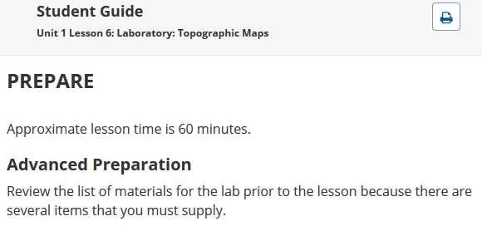
Offline Activities: Advance Preparation
The Advance Preparation section of the Student Guide tells you what you need to do ahead of time so you can successfully complete each lesson. To complete some lab lessons, for example, you will need to set up experiments several hours or days before the day of the lab so that you can record data or complete the final stage of an investigation during the lab lesson. For other lab lessons, you will need to gather simple materials before you begin.

Slide 10
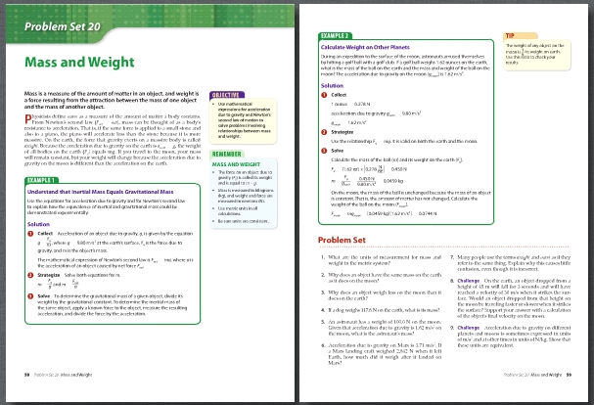
Offline Activities: Physics: Problems and Solutions
Physics: Problems and Solutions is an offline resource that contains step-by-step worked examples and study problems to help guide you through your learning.
The book contains a Solution Key with the answers to the problems.

Slide 11
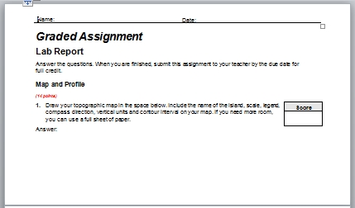
Grades
You will receive grades on several types of assessments, including Lesson Quizzes, Lab Reports, tests, discussions, and projects.

Slide 12
Grades: Graded Assignments
Some graded assignments are presented online and scored by the computer. Others are documents that you fill out and submit to the teacher. You may choose to complete each test document online or offline, and then submit it to the teacher. You will also be graded on your participation in online threaded discussions.

Slide 13
Online Discussions
Throughout this course you will be asked to participate in two types of online discussions.
Threaded discussions, also called asynchronous discussions, are discussion-board postings on various subjects that are pertinent to your learning. Some of these will involve science-related topics from your everyday life, and others will allow you to share your laboratory experiences and data with your fellow students.
Synchronous sessions are real-time, teacher-driven sessions that will help you prepare and conduct your labs. Your teacher will present tips and suggestions for you and your fellow students about each of the labs you conduct during this course.

